Slide 1
Tableau Module 1
Data Analytics

Slide 2


























Common Charts
Data Views
Hierarchies
Data Structures
Basic Navigation
Dashboards
Data Stories
Calculations
Advanced
Charts
Certification Springs
You are here
Blending
Done

Slide 3
Tableau
Tableau Software founded in 2003 in Mountain View, California
Tableau launched an initial public offering on the New York Stock Exchange on May 17, 2013
Acquired by Salesforce in 2019 for $15.7 billion
Tableau Desktop ($$)
Tableau Reader (free to use)
Tableau Public (free to use)
Can’t save privately
Limited to 1,000,000 records
A Leader in Business Intelligence Software

Slide 4
What is Business Intelligence?
Data Visualization: Turning data analysis into visual representations such as charts, graphs, and histograms to more easily consume data
Data mining: Using databases, statistics, and machine learning to uncover trends in large datasets
Reporting: Sharing data analysis to stakeholders so they can draw conclusions and make decisions
Performance metrics and benchmarking: Comparing current performance data to historical data to track performance against goals, typically using customized dashboards
Descriptive analytics: Using preliminary data analysis to find out what happened
Querying: Asking the data-specific questions, pulling the answers from the data sets
Statistical analysis: Taking the results from descriptive analytics and further exploring the data using statistics such as how this trend happened and why
Visual analysis: Exploring data through visual storytelling to communicate insights on the fly and stay in the flow of analysis
Data preparation: Compiling multiple data sources, identifying the dimensions and measurements, and preparing it for data analysis

Slide 5





Business Intelligence Tools

Slide 6
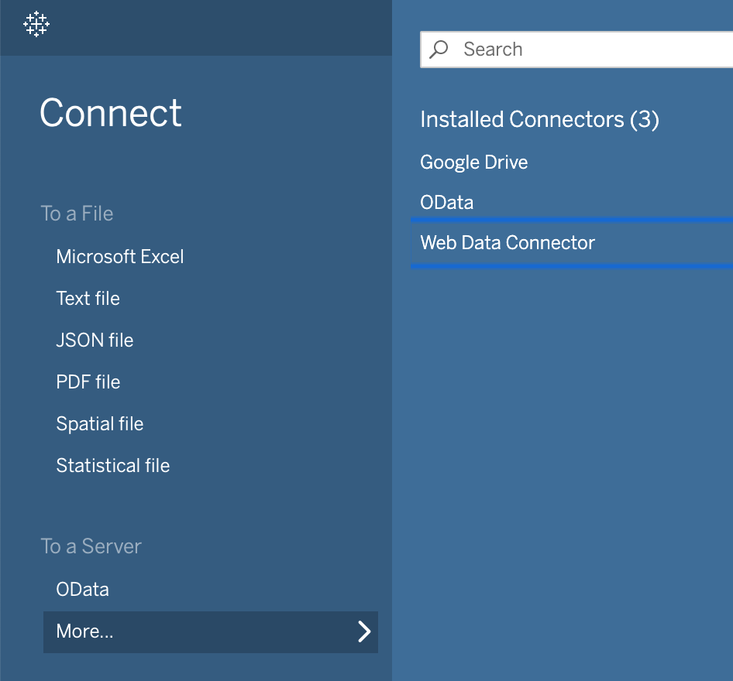
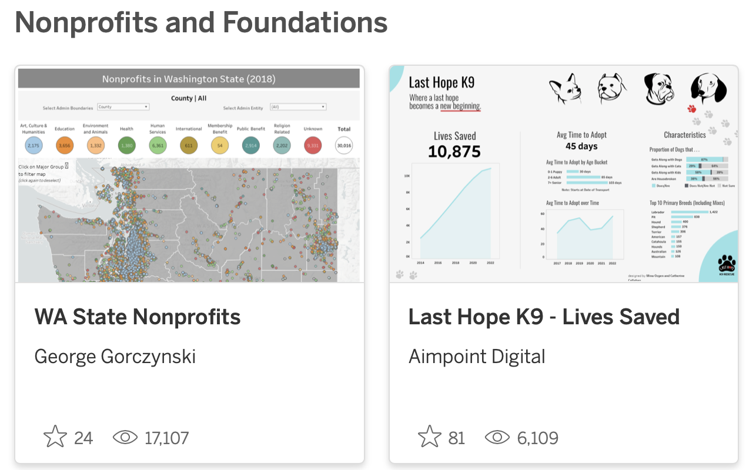
Tableau Interfaces
40 Data types and RDBMS*
Excel or .csv
GeoJSON
Rest API (OData
.twbx
*Tableau Desktop Only

Slide 7
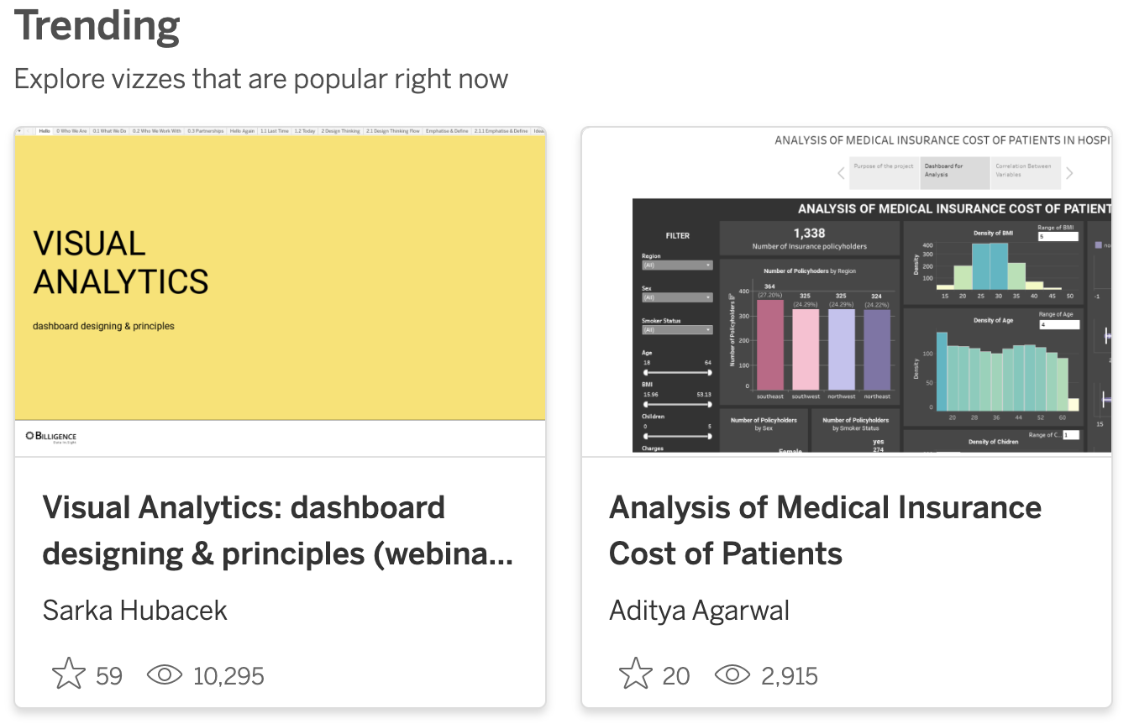
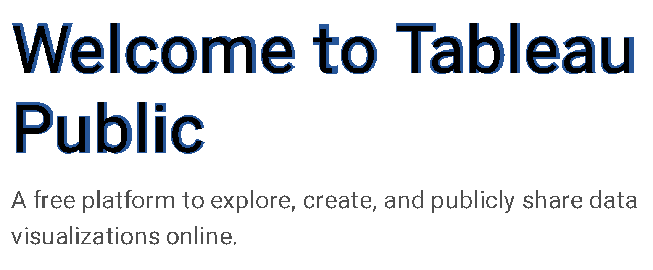
The Tableau Public Gallery
https://public.tableau.com/

Slide 8
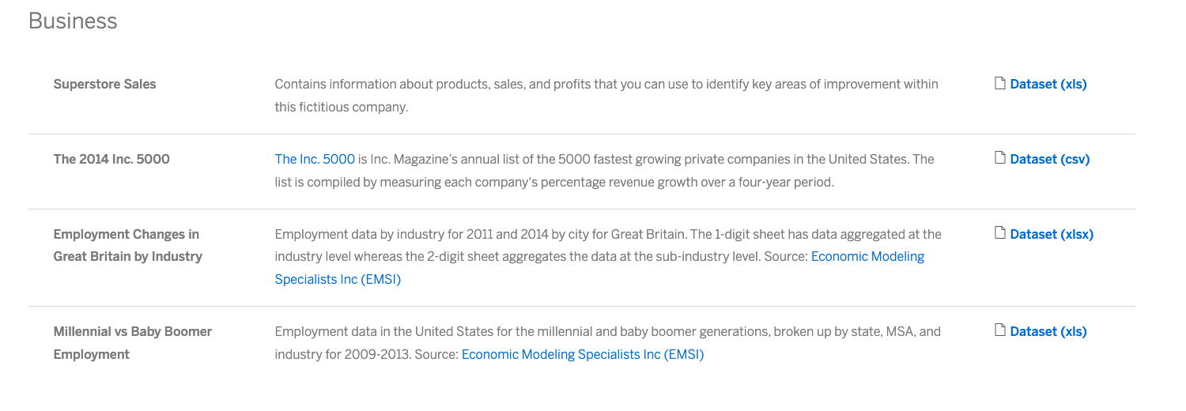
Sample Datasets
https://public.tableau.com/app/resources/sample-data

Slide 9


Tableau File Types
Tableau Workbook File (TWB) is an XML document
Tableau Packaged Workbook (TWBX) is a package of compressed files
The TWB file references a data source such as Excel or RDBMS and when you save the TWB file, it is linked to the source.
It includes a data source file, TWB, and any other file used to produce the workbook (including images).

Slide 10
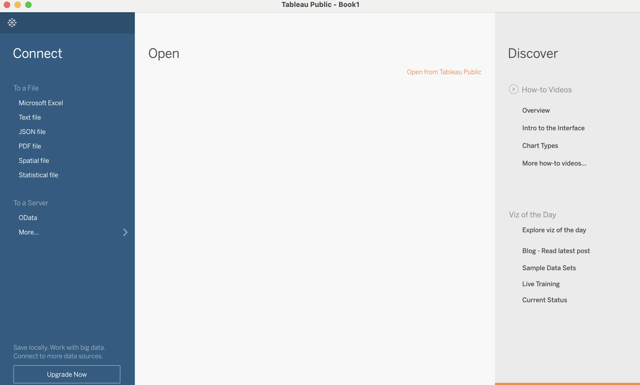
Connect or Open

Slide 11
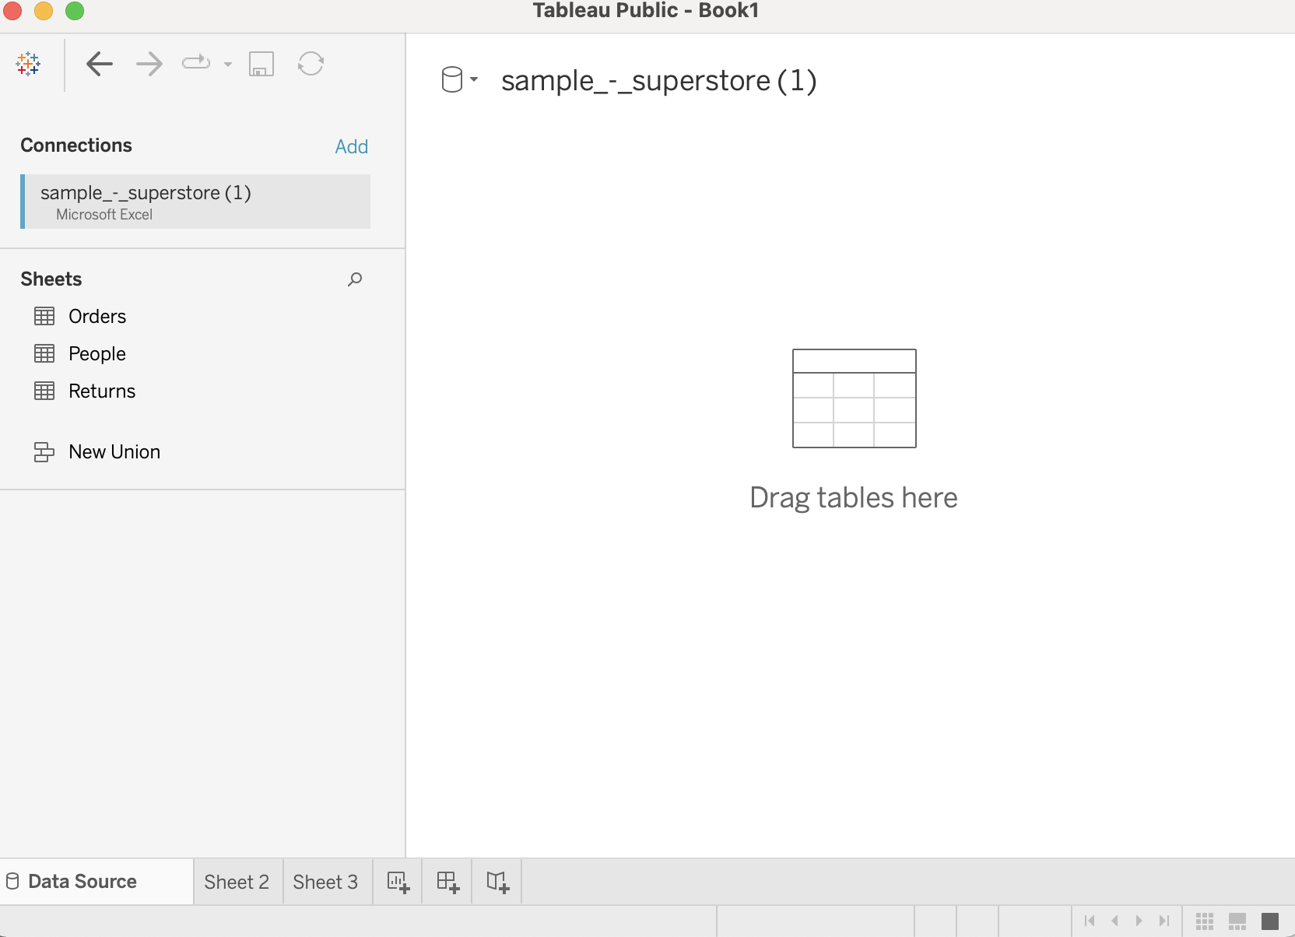
Excel Worksheets are Separate Tables

Slide 12
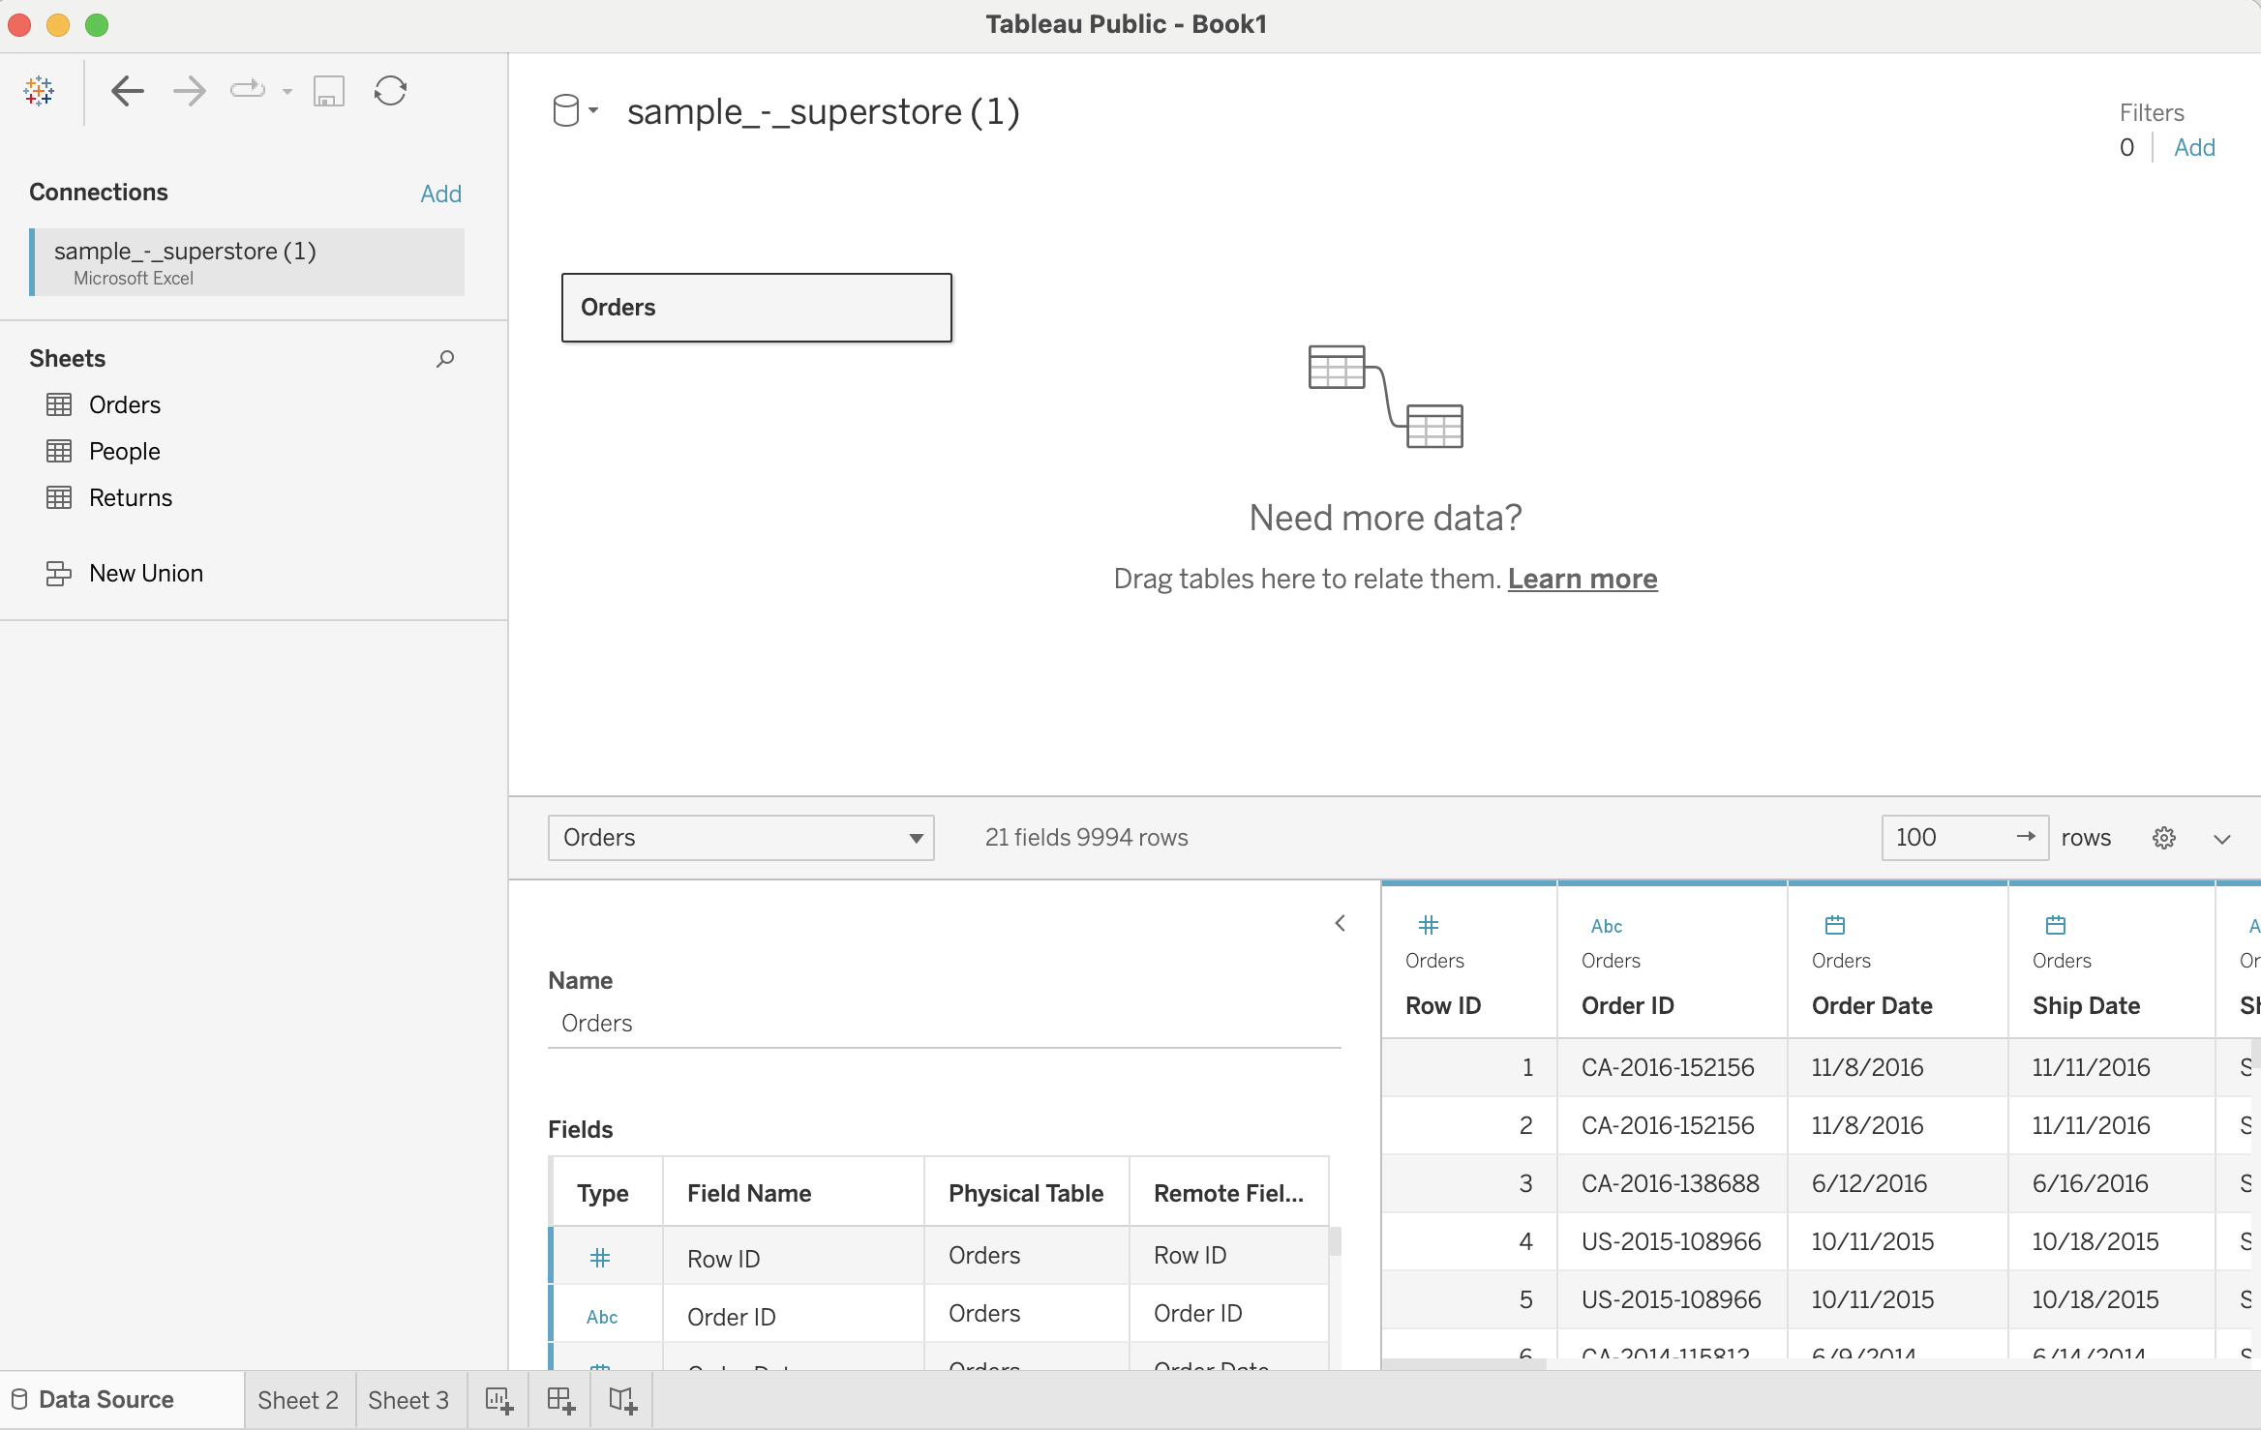

Slide 13
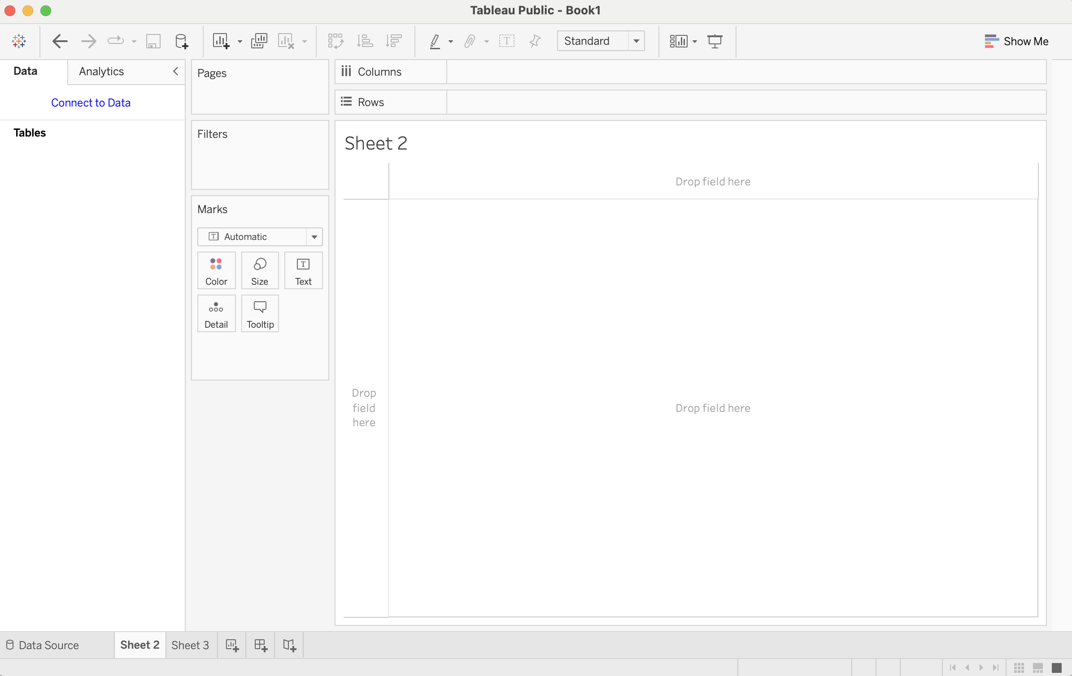
Tableau

Slide 14
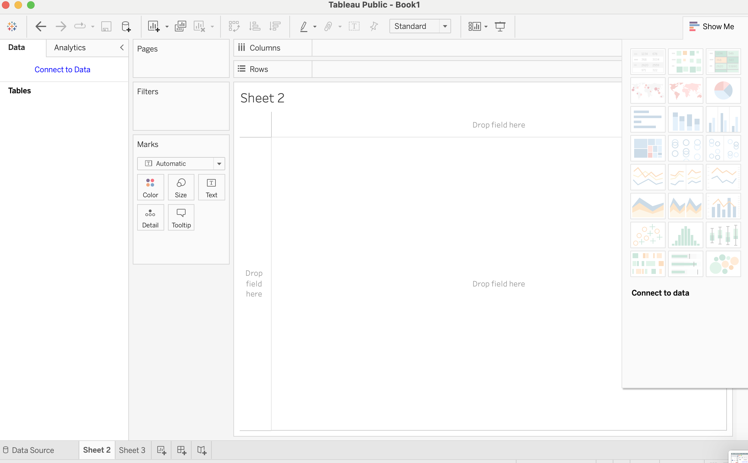

Slide 15
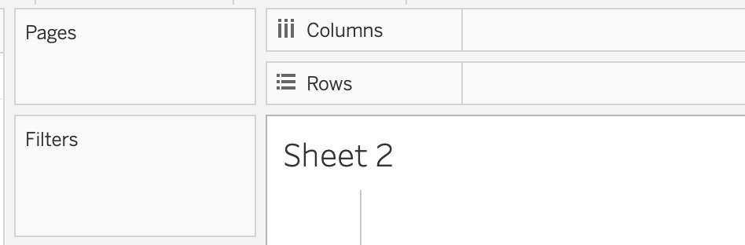
Shelves

Slide 16
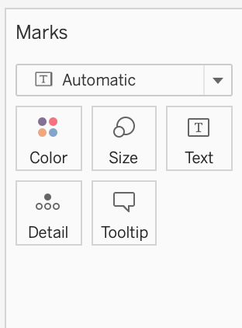
The Marks Card

Slide 17
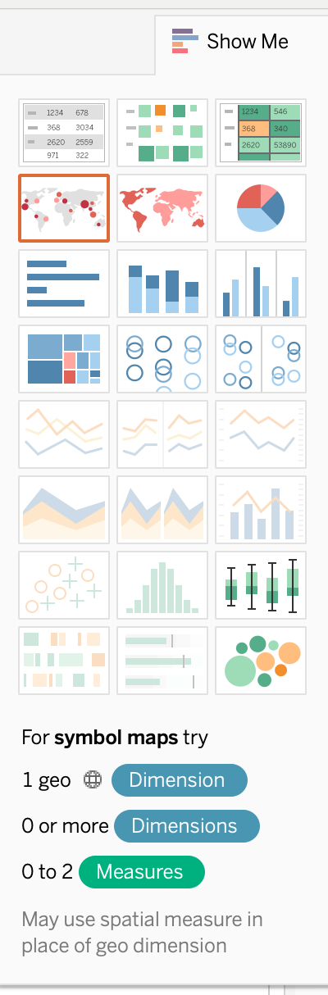
“Show Me” Panel
It’s retractable!
Select data and it will show you what kind of charts are compatible
Hover over a chart type and it will tell you what types of data you need to make it

Slide 18
Chart Types
Tables
Line
Bar
Scatter
Pie
Box
Histogram
Geo
Treemap
Area/Sand
Circles
Bullet
Hybrid

